Slide 1
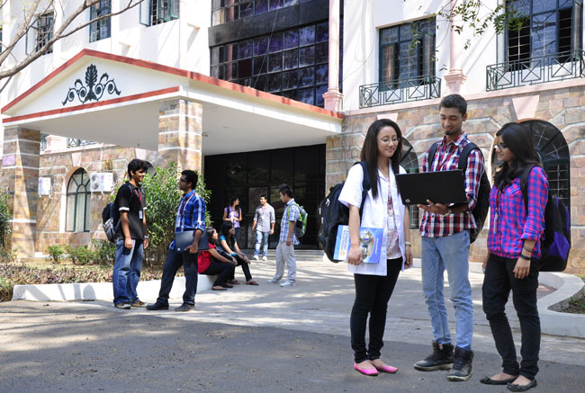

CSB4301 – Theory of Computation
B.Tech – Vth Semester
Department of Computer Science and Engineering

Slide 2
Applications of Regular Expressions
Used for representing generic templates in programming languages.
Ex: Checking the correct format for any given email id.
abc@def.ghi
In most operating systems ‘*’ means 0 or more or ‘?’ Means one
Used for representing generic templates in programming languages.

Slide 3
Applications of Regular Expressions - Checking email address
Used for representing generic templates in programming languages.
[A-Za-z] represents set of all alphabets
Then any string can be represented as [A-Za-z]*
[0=9] represents set of all number
Then any number can be represented as [0-9]*
then any email id can be represented as
([A-Za-z][0-9])*.@.([A-Za-z])*. ([A-Za-z])*
Many programming languages have predefined libraries for this.

Slide 4
Algebraic Laws of Regular Expressions
For the REs ‘P’ , M’ and ‘N’
Commutative(ness) of ‘+’
P+M=M+P
Commutative(ness) of ‘.’
P.M ≠ M.P
Associativity of OR ‘+’
(P+M)+N=P+(M+N)
Associativity of OR ‘.’
(P.M).N=P.(M.N)

Slide 5
Algebraic Laws of RE- Annihilators and Identities
L+φ = φ+L = L
ε.L= L.ε=L
L.φ = φ.L = φ

Slide 6
Algebraic Laws of RE- Distributive Laws
X.(Y+Z) = X.Y+X.Z
(X+Y).Z = X.Z+Y.Z
idempotent Laws
X.X ≠ X
X+X ≠ X

Slide 7
Laws involving closures
(L*)* = L*
Φ* = ε
ε*= ε

